Slide 1
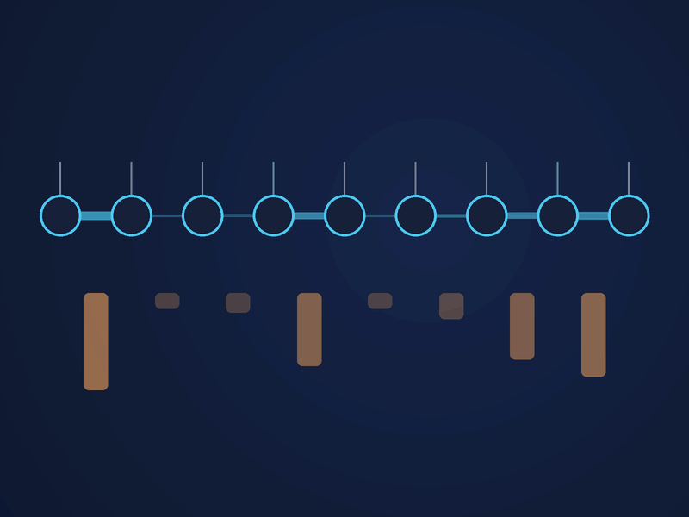
Quantum Circuit Simulation Runtime Predictions
QUANTUM RINGS · CIRCUIT RUNTIME CHALLENGE
Analysis with tensors, structural entanglement, MPS probes, and assorted parameter extraction
~90.3% on held-out circuits
Alice and Bob and Cosmo · Emma, Matthew, Tyler, Amelia

Slide 2
Given a circuit and threshold, predict the simulator’s run time
02 · Context
Provide Quantum Ring's simulator on Open Quantum with upfront pricing
0.15 s → 6 h
Runtimes span five orders of magnitude
532 × 5
Training circuits × thresholds (16 to 1024)
< 15 s
Per circuit to predict a runtime, without running it
Alice and Bob and Cosmo · Quantum Rings Runtime Challenge
02

Slide 3
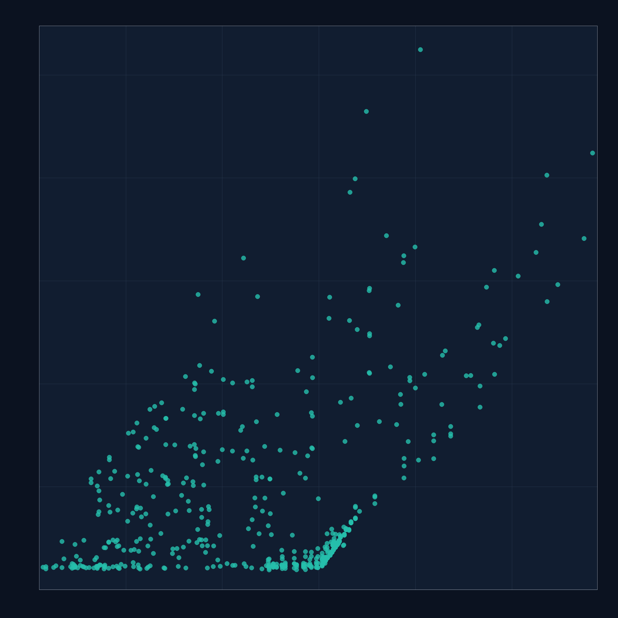
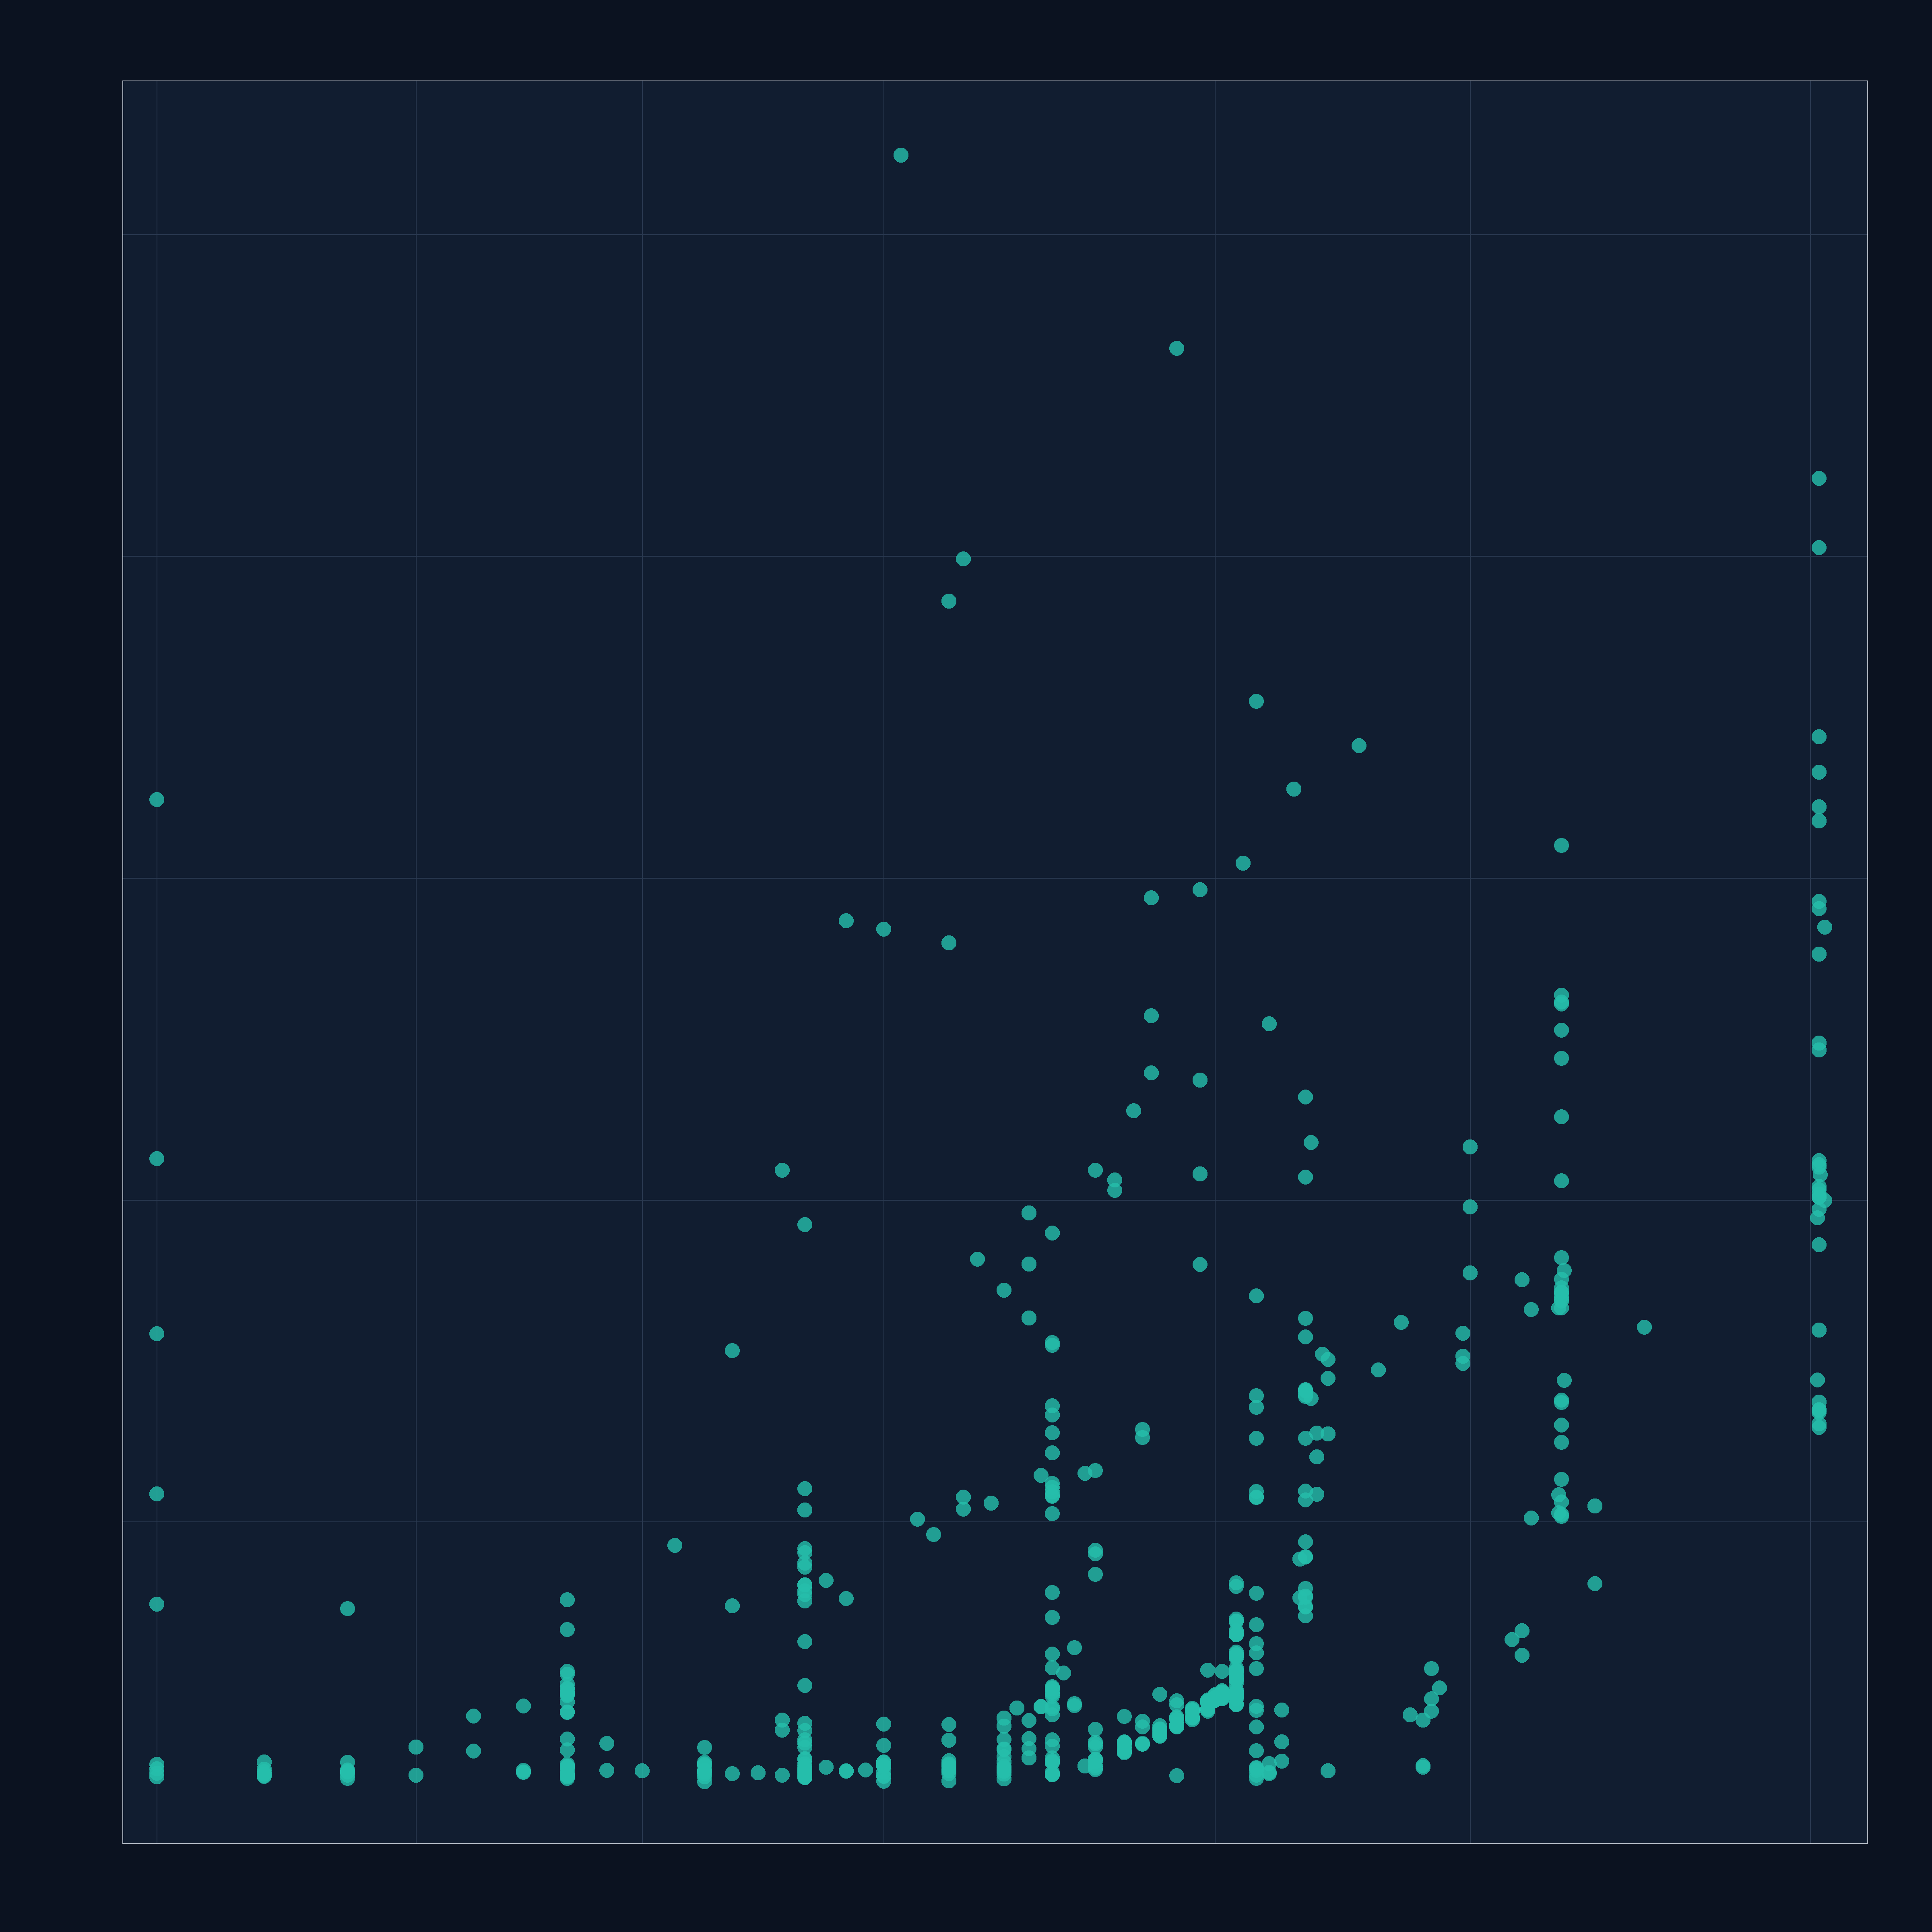
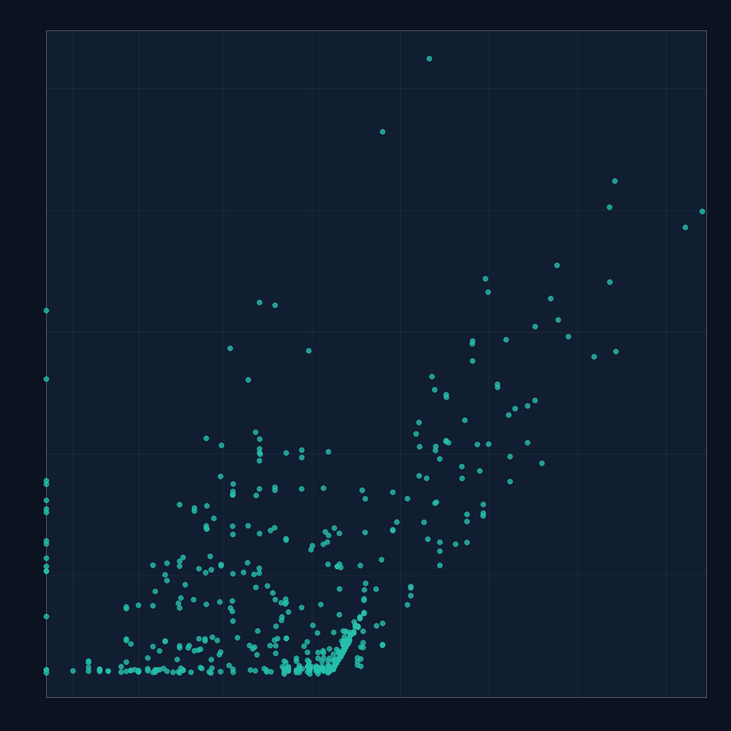
Number of gates, qubits, and two-qubit gates don’t predict runtime. Entanglement does.
03 · What didn't work
Gates
Qubits
Two-qubit gates
Runtime (s, log scale)
Runtime (s, log scale)
Runtime (s, log scale)
10k
10k
10k
1k
1k
1k
100
100
100
10
10
10
1
1
1
0.1
0.1
0.1
100
1k
10k
100k
1M
2
5
10
20
50
100
250
0
1
10
100
1k
10k
100k
1M
10M
QASM line count · log₁₀(1 + count)
Qubit count · log₁₀(1 + count)
Two-qubit gate count · log₁₀(1 + count)
Alice and Bob and Cosmo · Quantum Rings Runtime Challenge
03
Threshold = 16 · 526 completed runs · 4 timeouts omitted
Notes:
Amelia

Slide 4
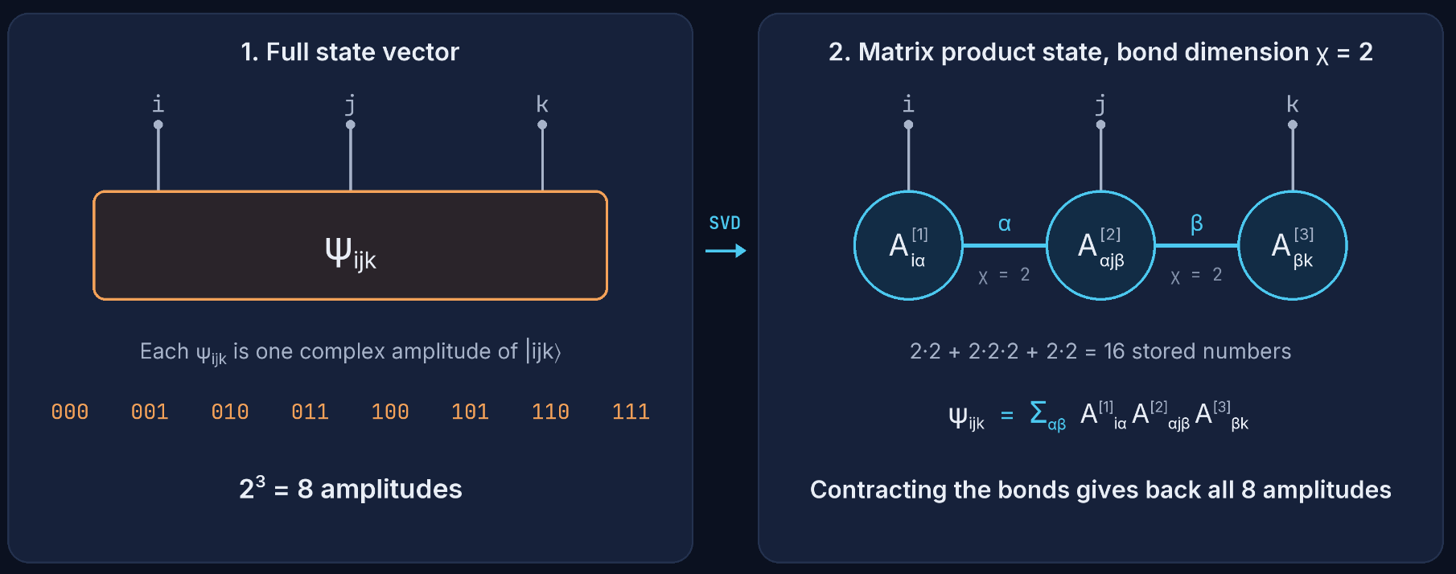
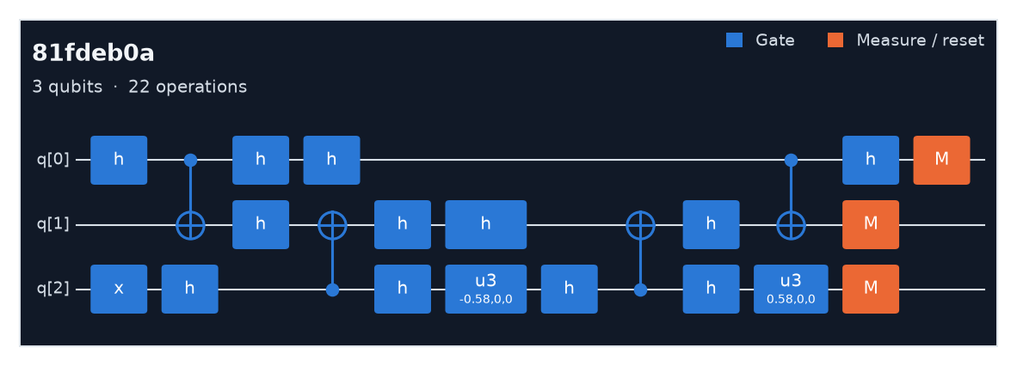
Matrix Product State Used to Simplify Entanglement
04 · What did work
Alice and Bob and Cosmo · Quantum Rings Runtime Challenge
04

Slide 5

Architecture Overview
05 · From feature to prediction
01
02
03
04
Feature Extraction
Timeout Check
Circuit Probe
Predict
Streams the expanded .qasm gate list to compute structural statistics and extract relevant features
A quick set of structural rules to flag if a circuit is likely to hit the 6 hour limit
Probes the MPS circuit using an aggressive truncation method to estimate entanglement growth rates
a physics-based cost formula predicts runtime using structural info and probe data.
Our primary innovations are in the center two steps – a quick overrun check and a circuit probe can significantly improve prediction accuracy
Alice and Bob and Cosmo · Quantum Rings Runtime Challenge
05
Notes:
Matthew

Slide 6
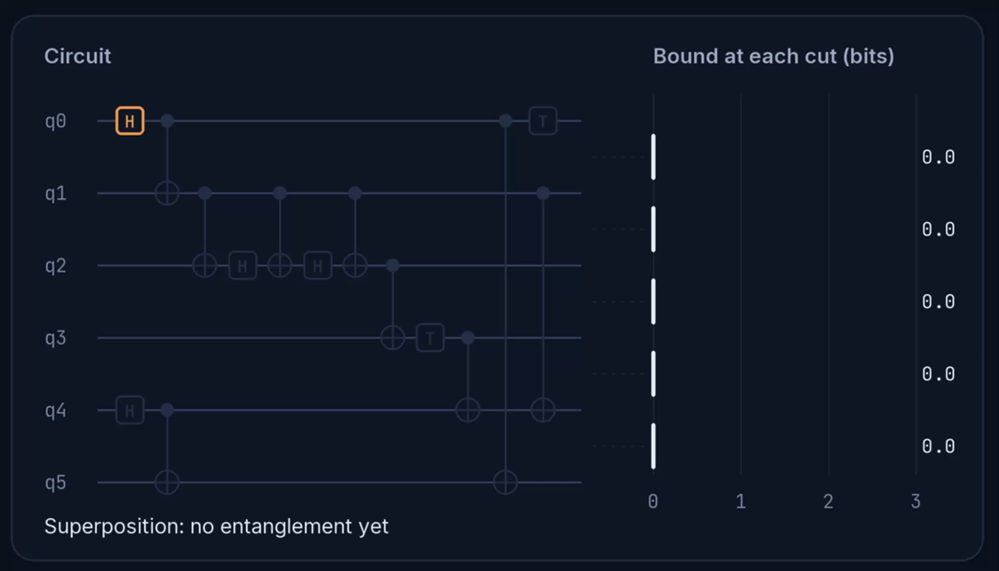
Feature Extraction: Entanglement from structure alone
06 · Feature Extraction
Upper bound
There is an upper limit to how much entanglement a single two qubit gate can generate – add this each time
Group bound
As the simulation progresses, qubits enter "groups" based on where entanglement may have spread
Product-state bound
Track Clifford gates / sequences exactly, and observe how these gates interact – only non-Clifford gates force entanglement
Estimated entanglement =
min (upper bound, group bound, product-state bound)
Alice and Bob and Cosmo · Quantum Rings Runtime Challenge
06

Slide 7
Timeout Check: Analysis of indicators for +6hr runtime
07 · Timeout check
Rule Sequence | Reason | Decision
Calculated entangling fraction > 0.5 | Circuits that barely create entanglement never timed out | Next Rule
Circuit reset count > 0 AND # of qubits ≥ 20 | Large circuits with mid-circuit resets, typically Grover-style, consistently ran past 6h | Flagged
# of qubits ≥ 100 AND # of unique qubit pairs ≥ 60 AND depth ≥ 2000 AND nearest neighbor fraction < 0.03 AND density ≥ 0.9 AND threshold ≥ 512 | Wide, nearly all-to-all circuits: almost every qubit pair interacts and almost no gates are between neighbors, so entanglement spreads across the whole qubit chain | Flagged
Qubits ≥ 32 AND density ≥ 0.95 AND two-qubit gates per pair ≥ 35 AND gates per qubit ≥ 2300 | Repetitive, rotation-heavy all-to-all circuits: the same pairs interact again and again, so the bonds fill up. The more gates per qubit, the lower the threshold where they time out | Threshold ≥ 256 & gates/qubit ≥ 12,000: Flagged Threshold ≥ 512 $ gates/qubit ≥ 4,000: Flagged Threshold ≥ 1024
Alice and Bob and Cosmo · Quantum Rings Runtime Challenge
07
Notes:
Matthew

Slide 8
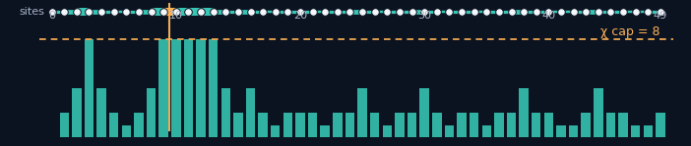
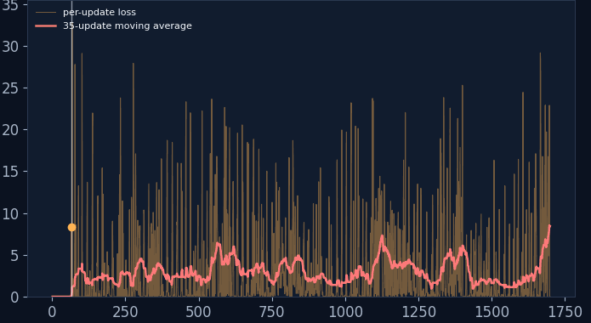
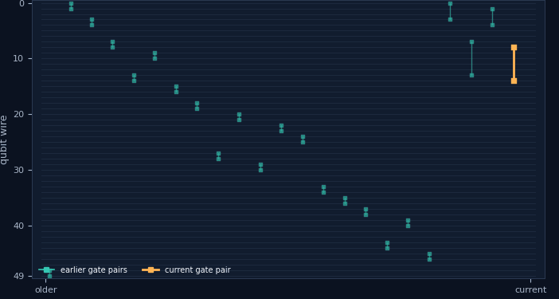
08 · Circuit Probe
Circuit Probe: MPS Bond Length Growth Estimator
Bond profile across the 50-site chain (700c376b.qasm)
What each SVD update discards
50-qubit circuit · 14,998 operations · maximum retained bond dimension χ = 8
Circuit window: recent two-qubit interactions
Per-update loss and 35-update moving average
1,442 / 1,700
32.85%
updates exceeded χ = 8
(84.8% of updates)
largest observed discarded
squared weight in one update
50 wires are qubits. Teal marks earlier gate pairs; amber marks the current pair.
SVD update = simulation progress, not wall-clock time.
Alice and Bob and Cosmo · Quantum Rings Runtime Challenge
Notes:
Amelia

Slide 9
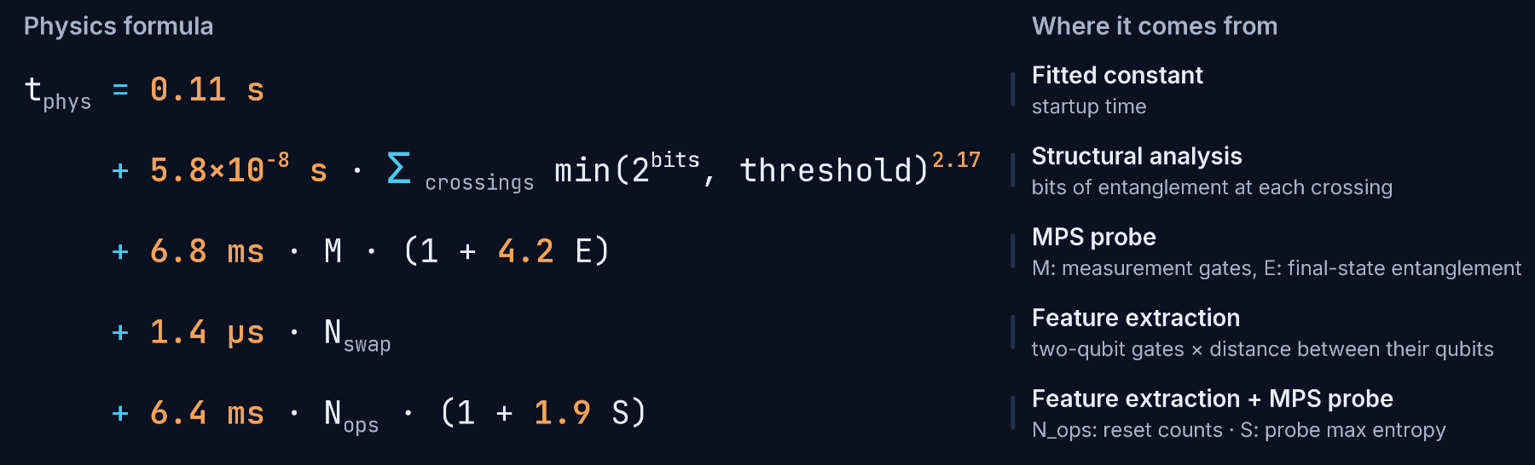
Predict: Finding runtime from extracted features
09 · Prediction
Alice and Bob and Cosmo · Quantum Rings Runtime Challenge
09

Slide 10
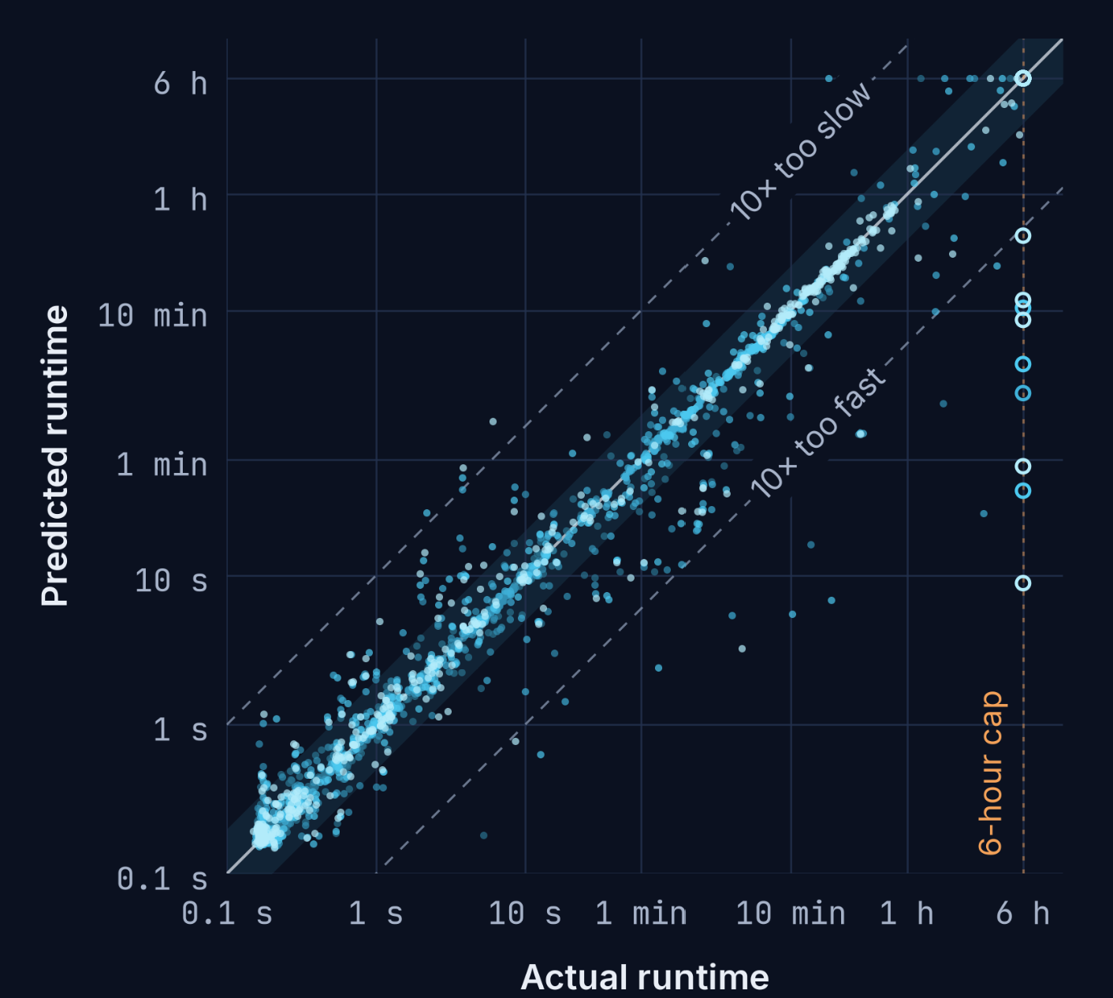
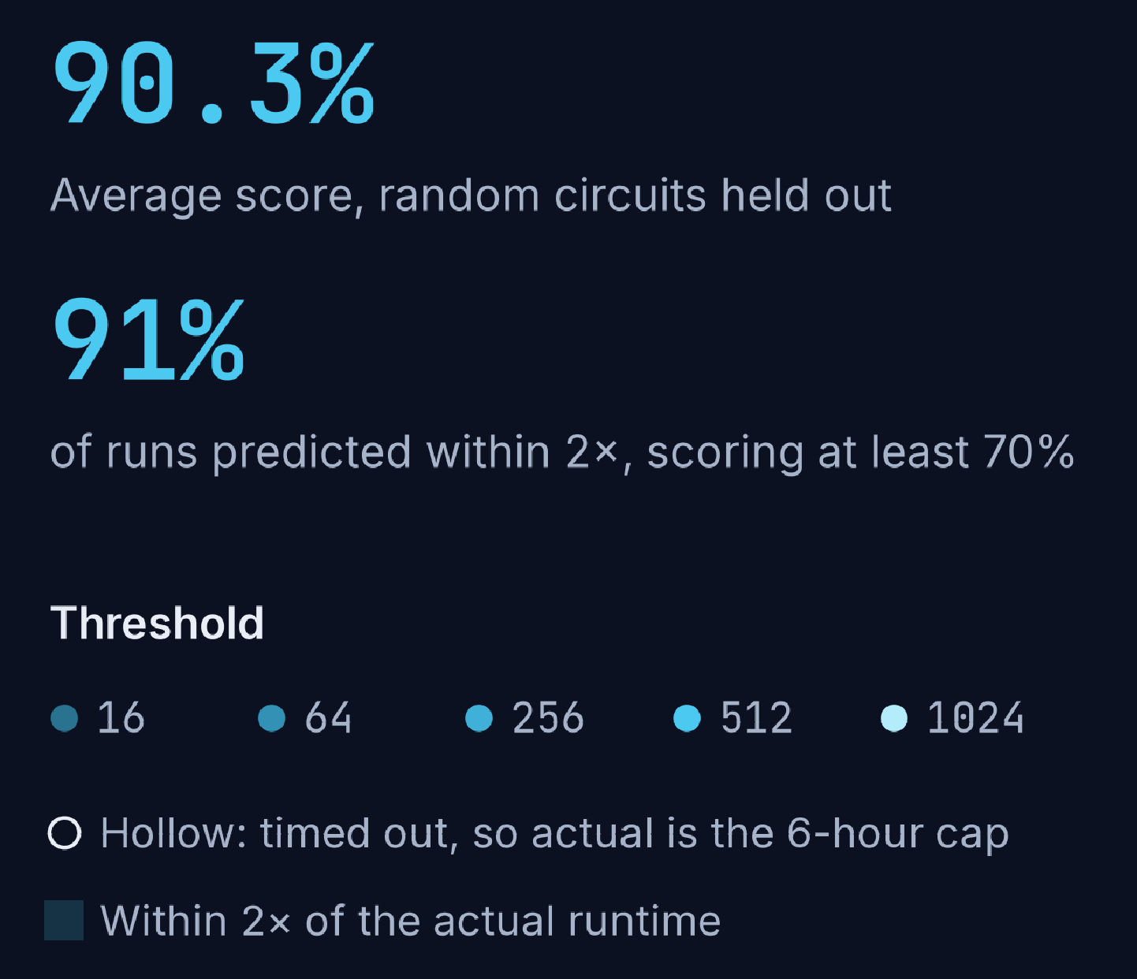
Accuracy on circuits the model never saw
10 · Results
90.3%
Random circuits held out
87.8%
Similar circuits held out
70.9%
Whole gate-set families held out
X%
Official scorer
Alice and Bob and Cosmo · Quantum Rings Runtime Challenge
10

Slide 11
An analysis of the biggest gains
11 · Iteration
Idea | Measured effect | Decision
Small MPS probes (χ= 8, 16) | +10 point increase | Kept
Timeout check | +1.5 point increase | Kept
Fitting qubit rotation angles, load into model | +0.5 increase | Kept
Neural network integration | −6 on unseen families (indicates overfitting) | Dropped
Starting MPS probes mid circuit | No gain | Dropped
Higher χ (64–128) on short circuits | Up to 56 s per circuit, over the limit | Dropped
All these were validated with separate test samples including random circuits, similar-size groups, and whole gate-set families held out
Alice and Bob and Cosmo · Quantum Rings Runtime Challenge
11

Slide 12
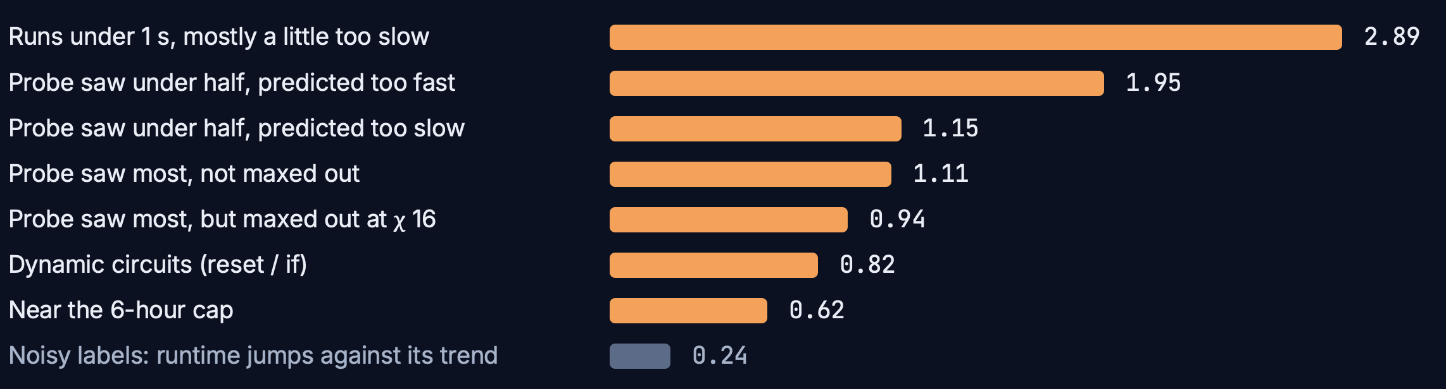

Where the remaining 9.7 points go
12 · Error Results
About 1.4 points are measurement noise: runs can vary 3–5%. That leaves about 8.3 points left.
Alice and Bob and Cosmo · Quantum Rings Runtime Challenge
12

Slide 13
Questions?
13 · Takeaways
1
Runtime is not directly correlated to any one feature; instead we used MPS to estimate bond order.
2
The model was trained on a random 80% and validated on the other 20%.
3
The run time was estimated with 90.3% accuracy on the 20%.
Alice and Bob and Cosmo · Quantum Rings Runtime Challenge
13

